Slide 1


Slide 2
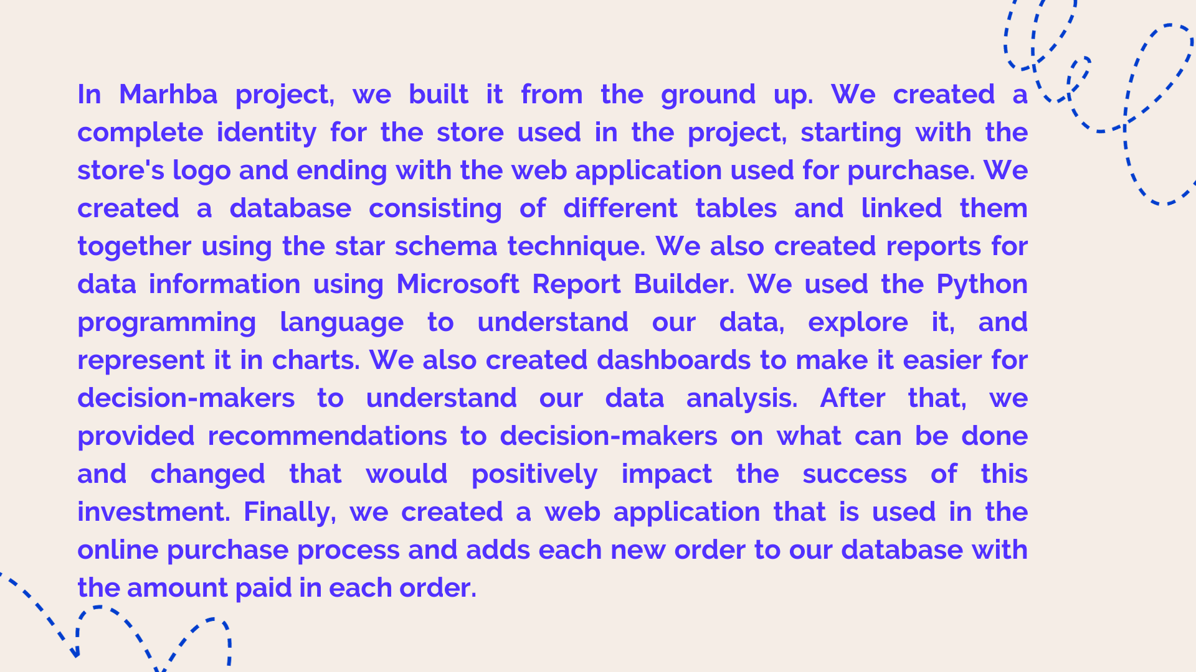

Slide 3


Slide 4

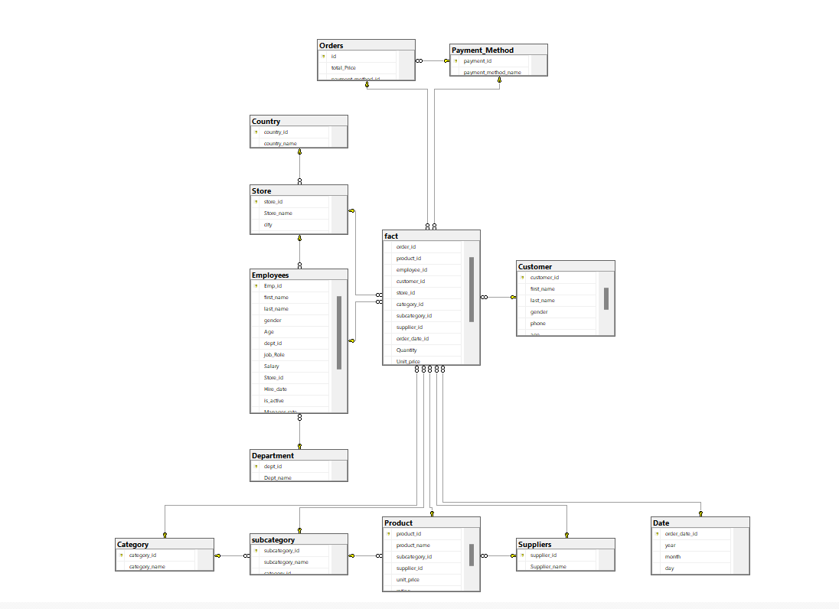
Database Diagram
(Data Warehouse)

Slide 5
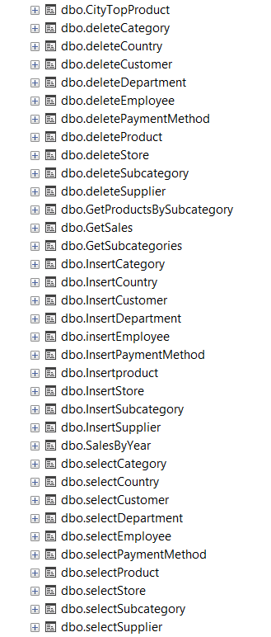
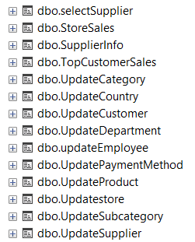
Stored Procedures

Slide 6


Slide 7
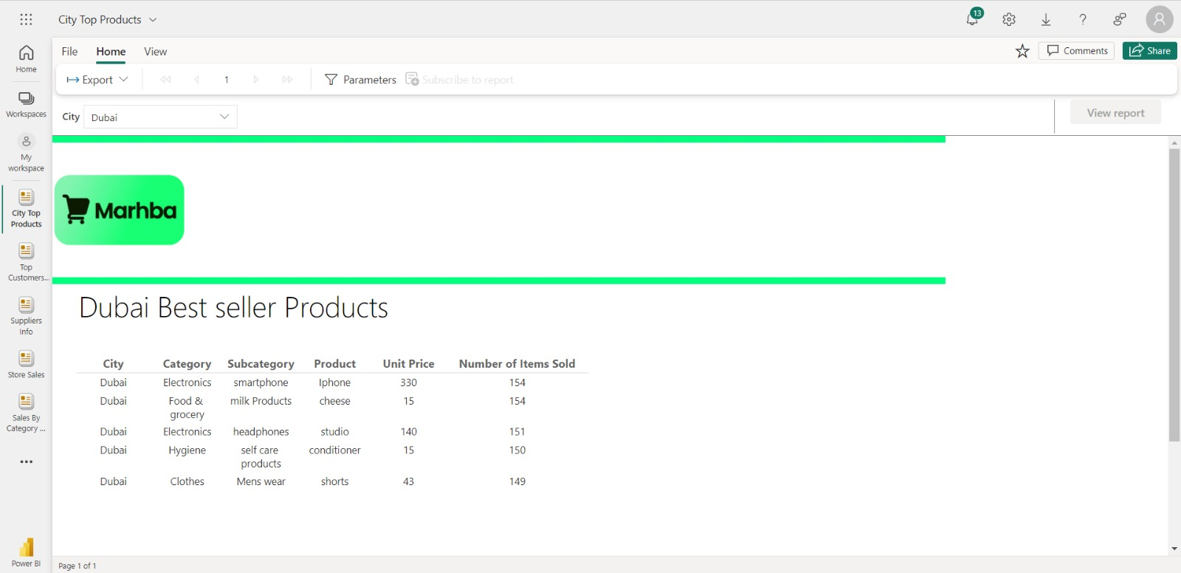


Slide 8
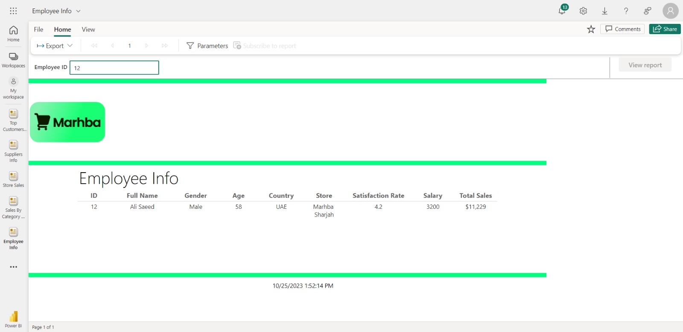

Slide 9
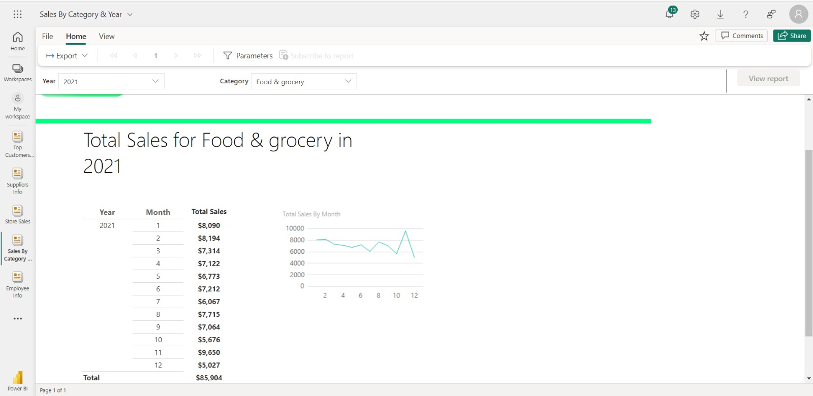

Slide 10
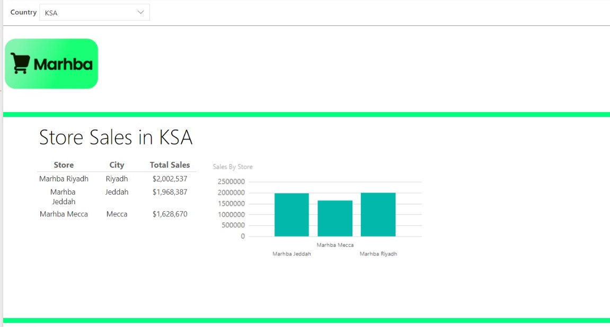

Slide 11
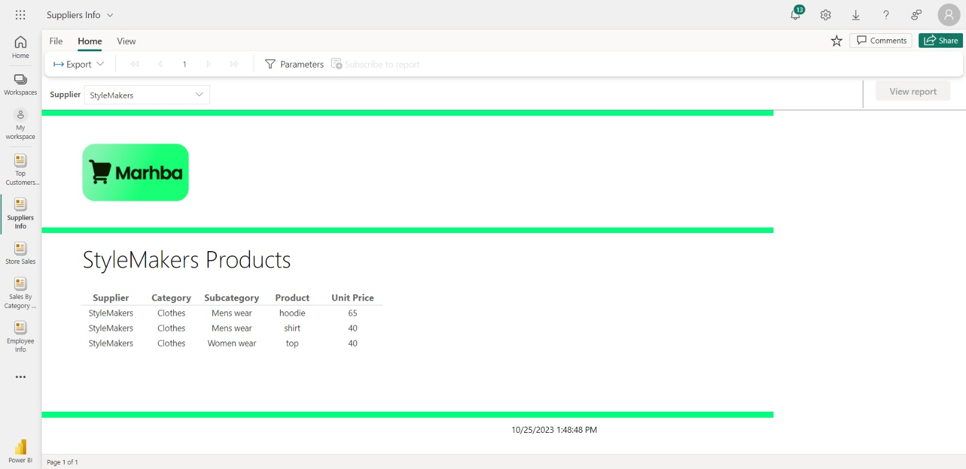

Slide 12
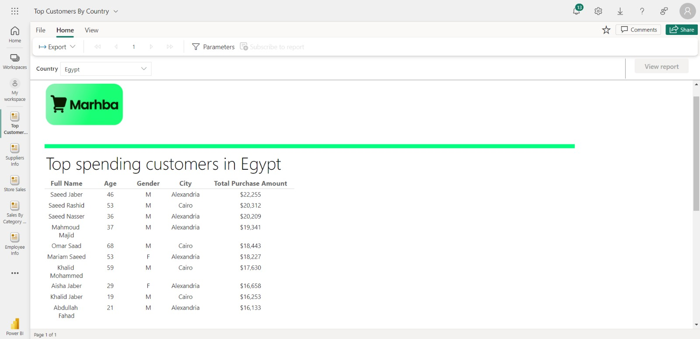

Slide 13


Slide 14
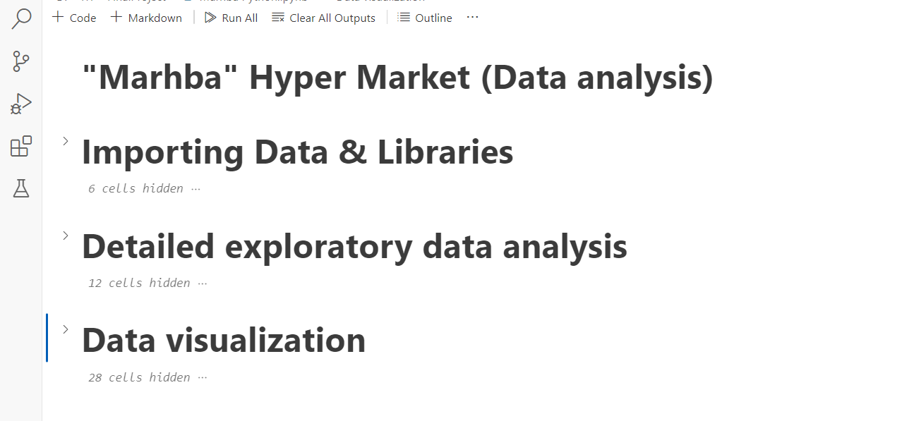

Slide 15
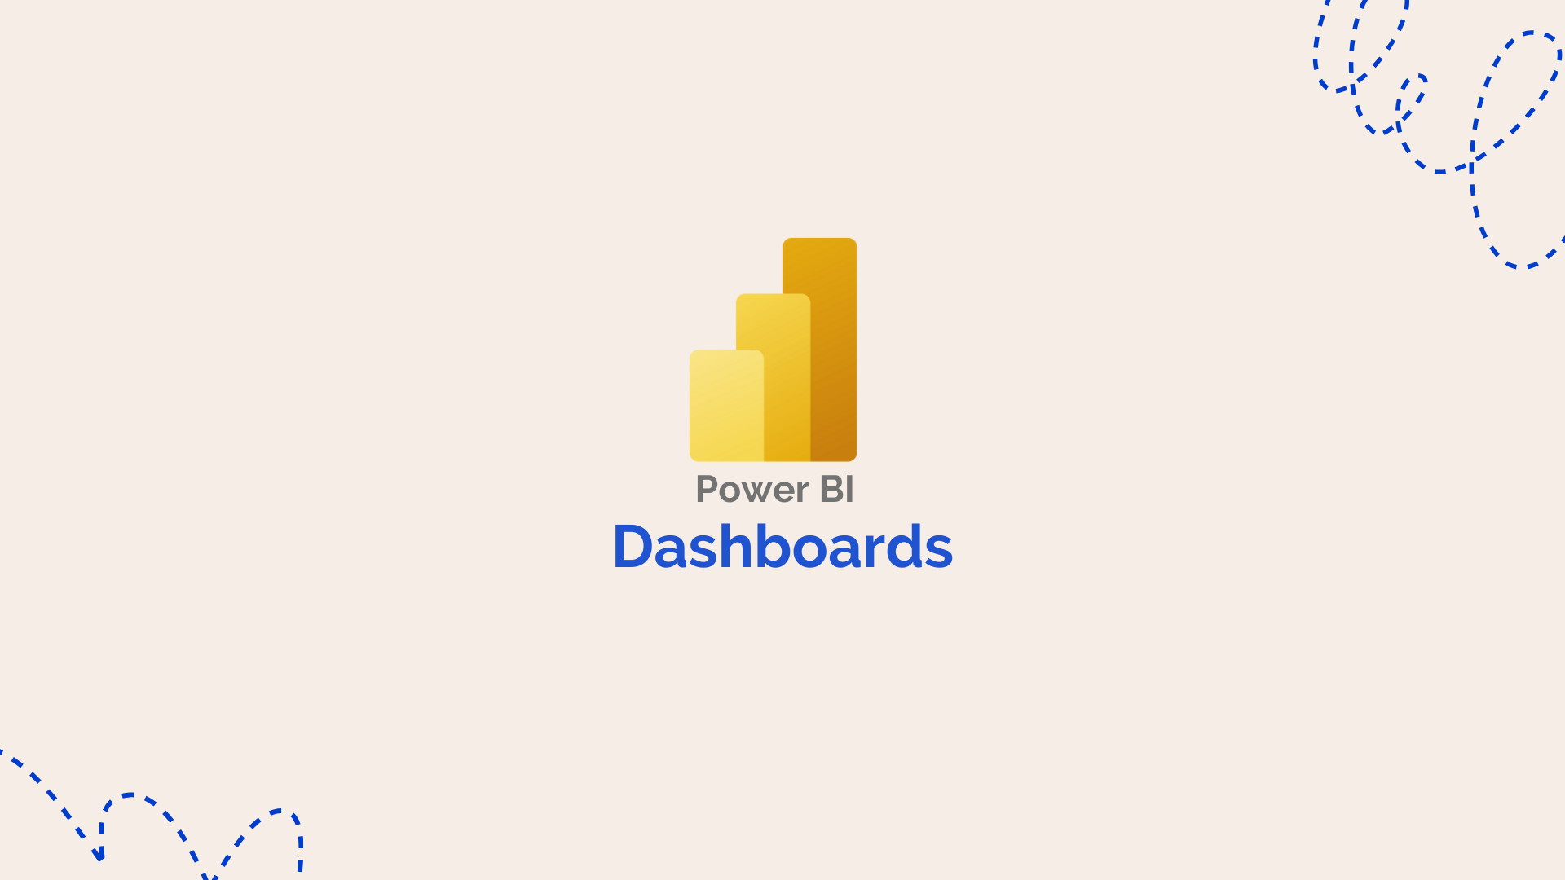
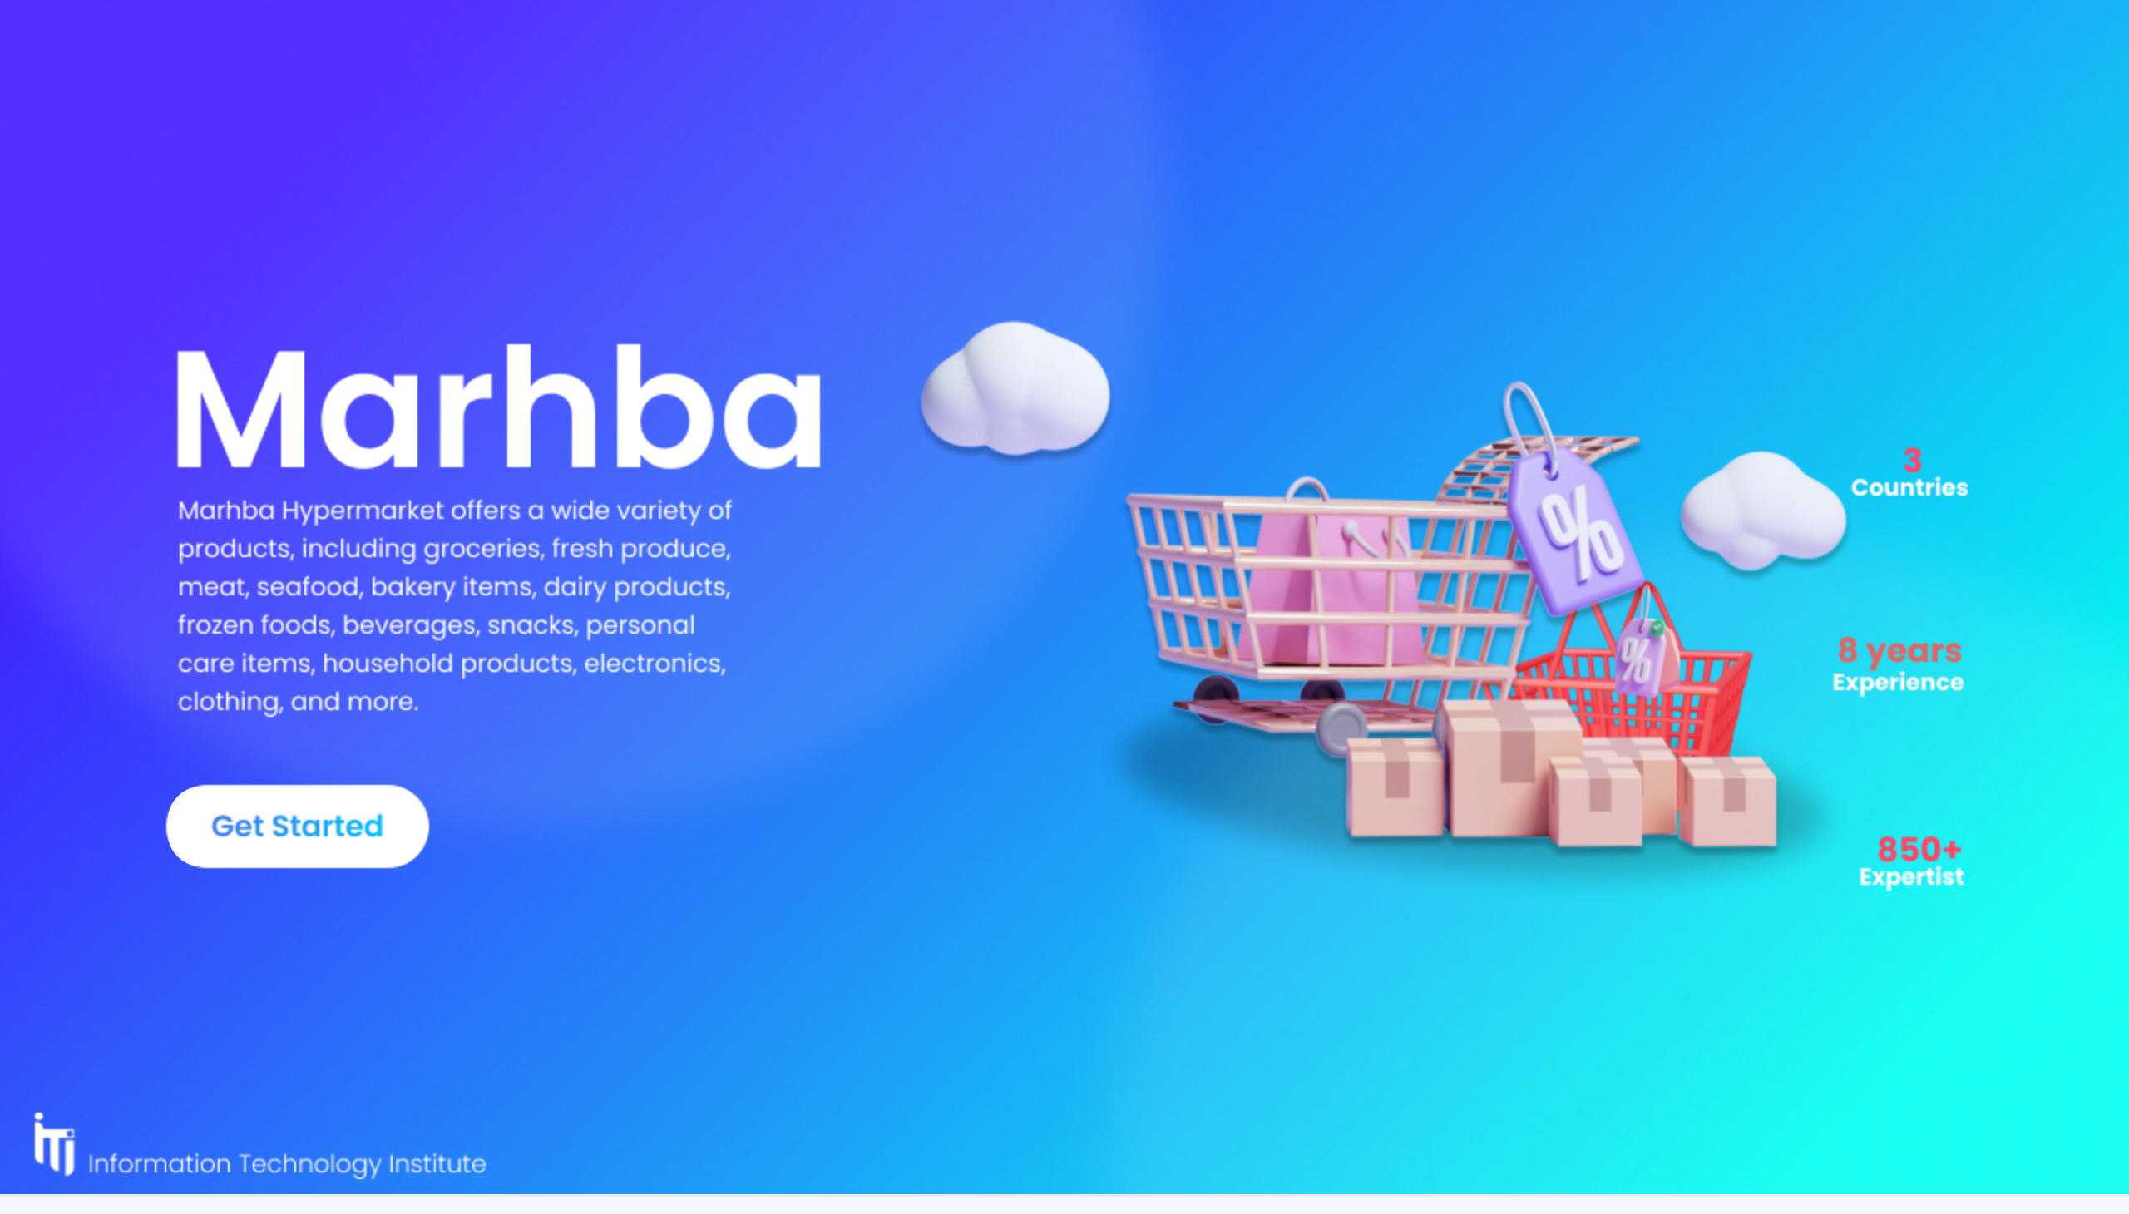
Home
Notes:
actionButton
No alt text provided

Slide 16
Home
Notes:
actionButton
No alt text provided

Slide 17

Main
Notes:
actionButton
No alt text provided
actionButton
No alt text provided
actionButton
No alt text provided
actionButton
No alt text provided
actionButton
No alt text provided

Slide 18
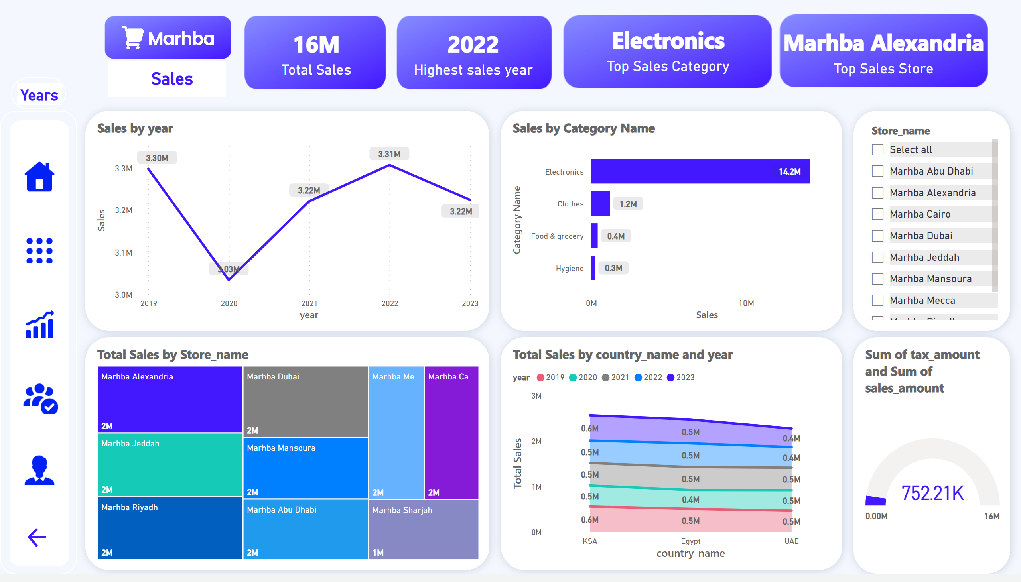
Sales Overview
Notes:
card
No alt text provided
card
No alt text provided
card
No alt text provided
lineChart
No alt text provided
barChart
No alt text provided
treemap
No alt text provided
stackedAreaChart
No alt text provided
card
No alt text provided
slicer
No alt text provided
gauge
No alt text provided
textbox
No alt text provided
image
No alt text provided
image
No alt text provided
image
No alt text provided
image
No alt text provided
image
No alt text provided
image
No alt text provided
image
No alt text provided
actionButton
No alt text provided
actionButton
No alt text provided
actionButton
No alt text provided
actionButton
No alt text provided
actionButton
No alt text provided
actionButton
No alt text provided
actionButton
No alt text provided

Slide 19
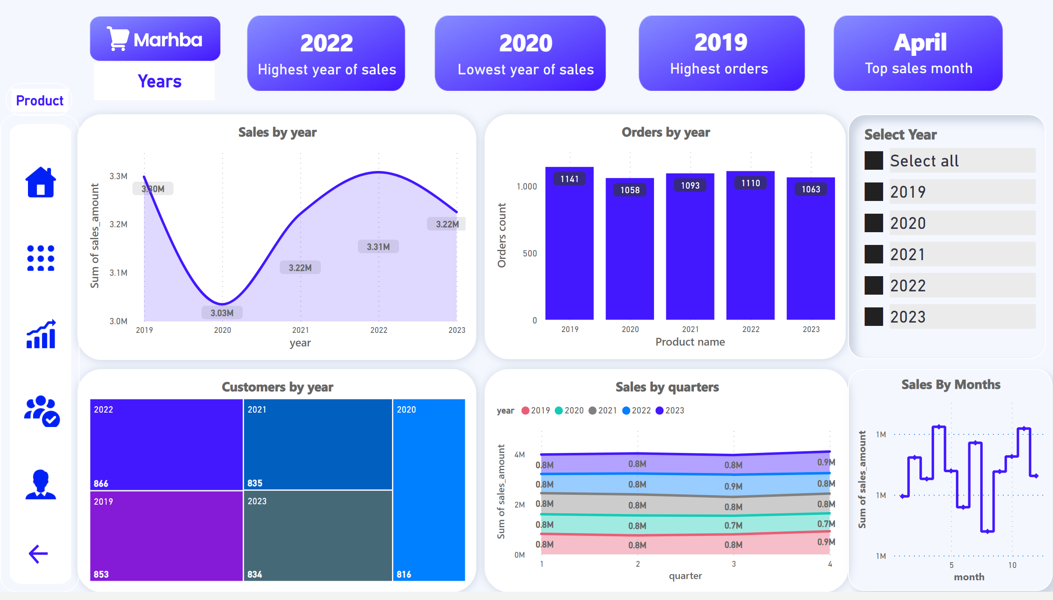
years
Notes:
image
No alt text provided
image
No alt text provided
image
No alt text provided
image
No alt text provided
image
No alt text provided
image
No alt text provided
image
No alt text provided
textbox
No alt text provided
actionButton
No alt text provided
actionButton
No alt text provided
actionButton
No alt text provided
actionButton
No alt text provided
actionButton
No alt text provided
actionButton
No alt text provided
actionButton
No alt text provided
actionButton
No alt text provided
actionButton
No alt text provided
actionButton
No alt text provided
actionButton
No alt text provided
actionButton
No alt text provided
Sales by year
No alt text provided
card
No alt text provided
Customers by year
No alt text provided
card
No alt text provided
slicer
No alt text provided
Sales by quarters
No alt text provided
card
No alt text provided
Sales By Months
No alt text provided
card
No alt text provided
Orders by year
No alt text provided

Slide 20
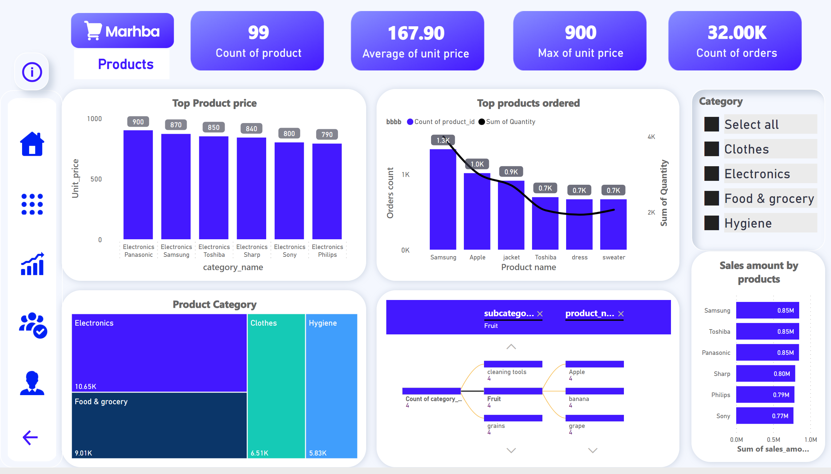
Product
Notes:
Top Product price
No alt text provided
Top products ordered
No alt text provided
Product Category
No alt text provided
decompositionTreeVisual
No alt text provided
Category
No alt text provided
Sales amount by products
No alt text provided
card
No alt text provided
card
No alt text provided
card
No alt text provided
card
No alt text provided
image
No alt text provided
image
No alt text provided
image
No alt text provided
image
No alt text provided
image
No alt text provided
image
No alt text provided
image
No alt text provided
textbox
No alt text provided
actionButton
No alt text provided
actionButton
No alt text provided
actionButton
No alt text provided
actionButton
No alt text provided
actionButton
No alt text provided
actionButton
No alt text provided
actionButton
No alt text provided

Slide 21
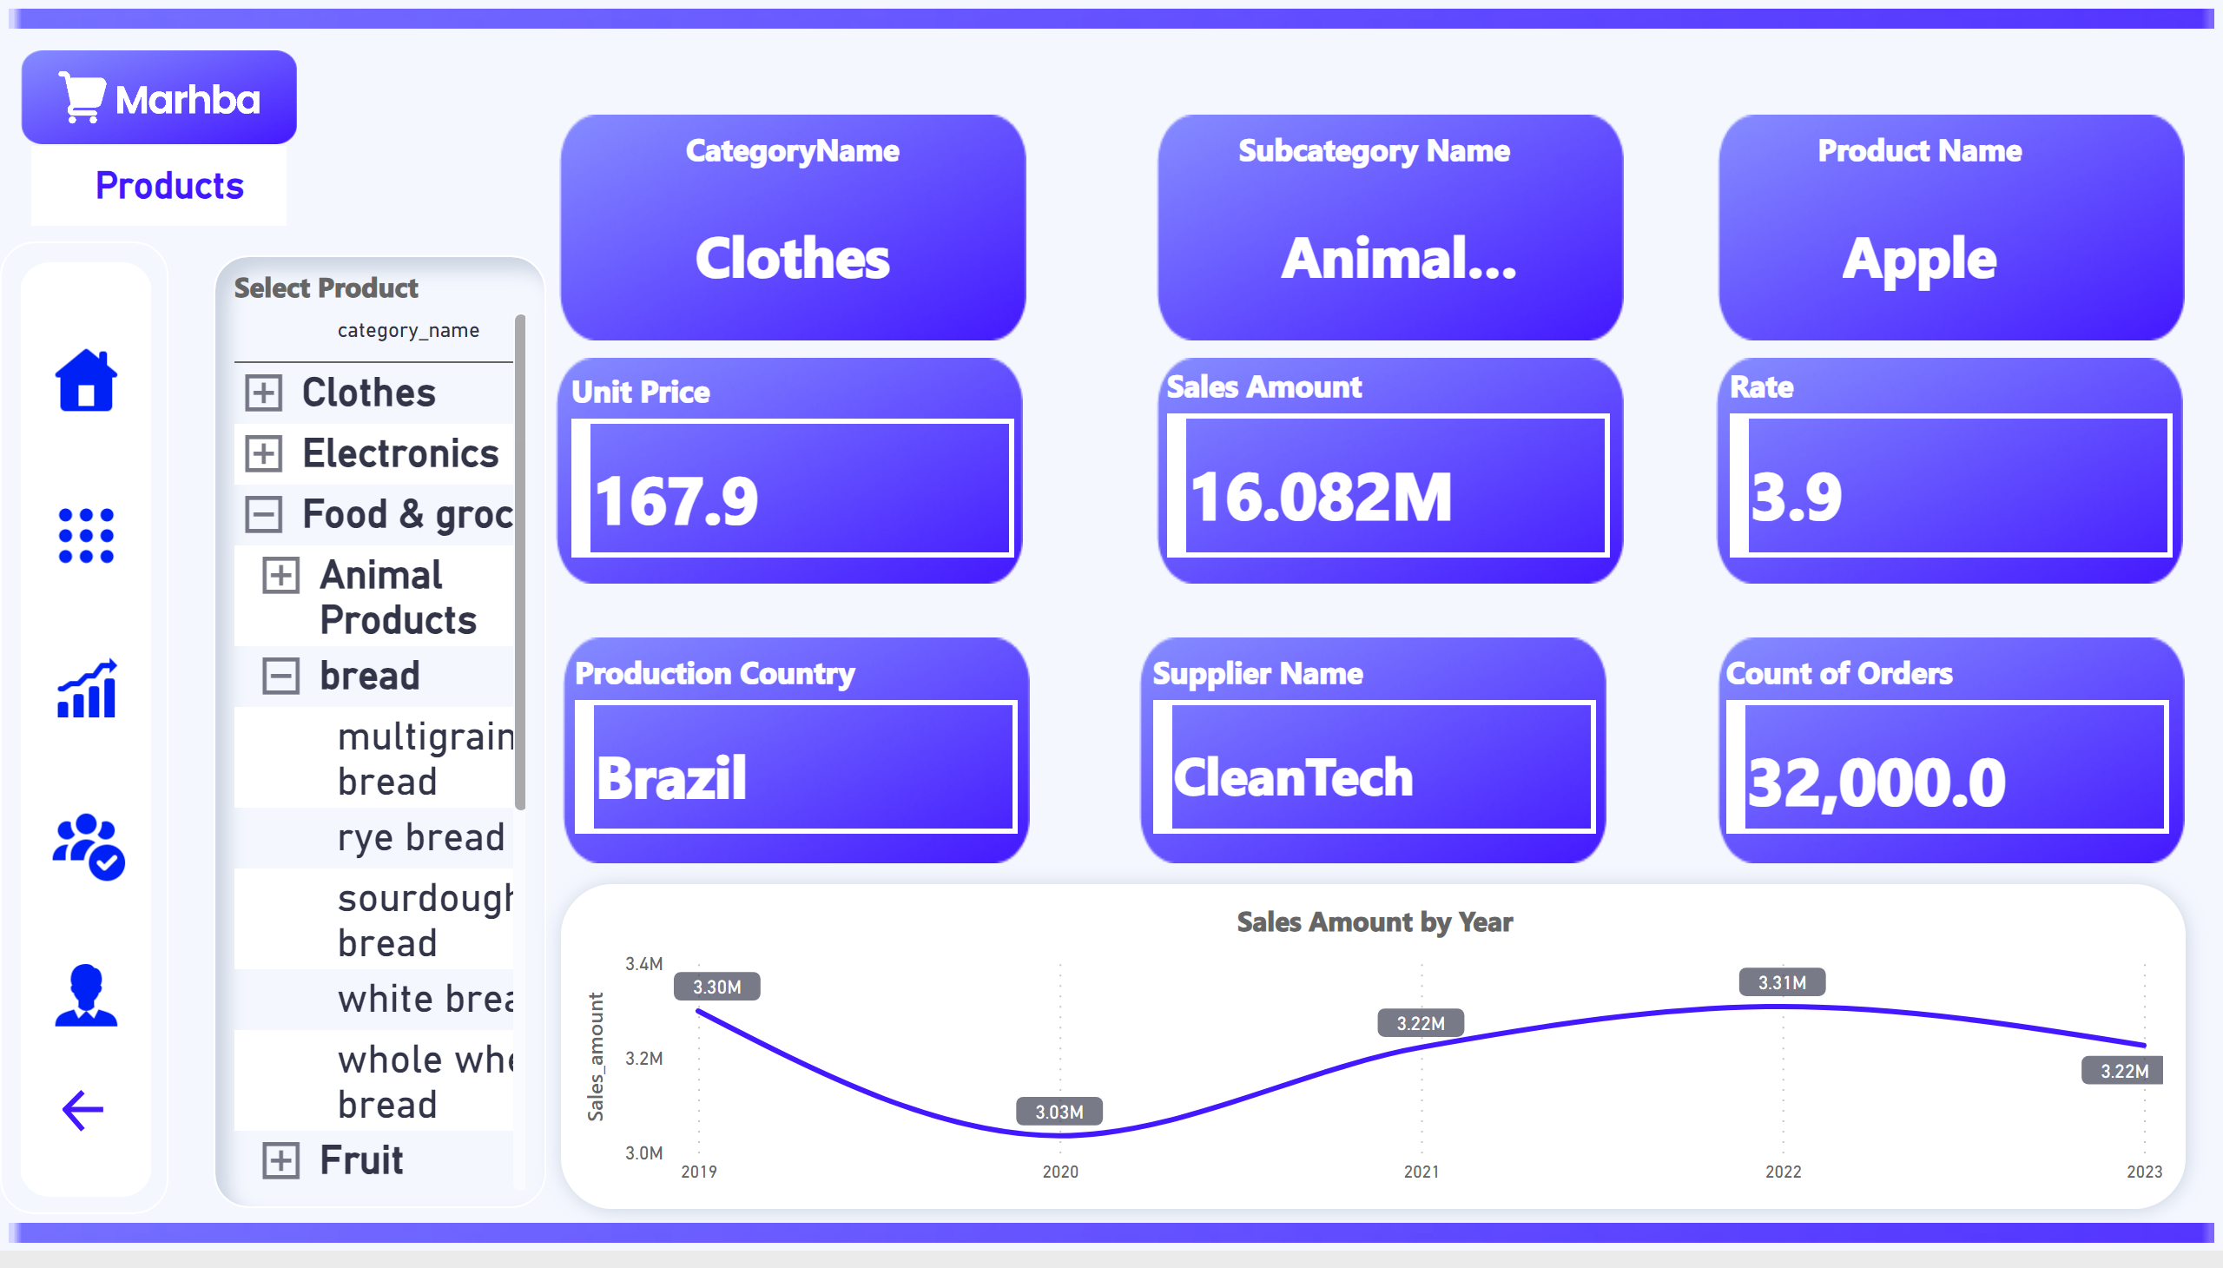
Products Inact
Notes:
Select Product
No alt text provided
Unit Price
No alt text provided
Sales Amount
No alt text provided
Rate
No alt text provided
Production Country
No alt text provided
Supplier Name
No alt text provided
Product Name
No alt text provided
Count of Orders
No alt text provided
Subcategory Name
No alt text provided
CategoryName
No alt text provided
Sales Amount by Year
No alt text provided
image
No alt text provided
image
No alt text provided
image
No alt text provided
image
No alt text provided
image
No alt text provided
image
No alt text provided
image
No alt text provided
image
No alt text provided
image
No alt text provided
textbox
No alt text provided
image
No alt text provided
image
No alt text provided
image
No alt text provided
actionButton
No alt text provided
image
No alt text provided
image
No alt text provided
actionButton
No alt text provided
actionButton
No alt text provided
actionButton
No alt text provided
actionButton
No alt text provided
actionButton
No alt text provided

Slide 22
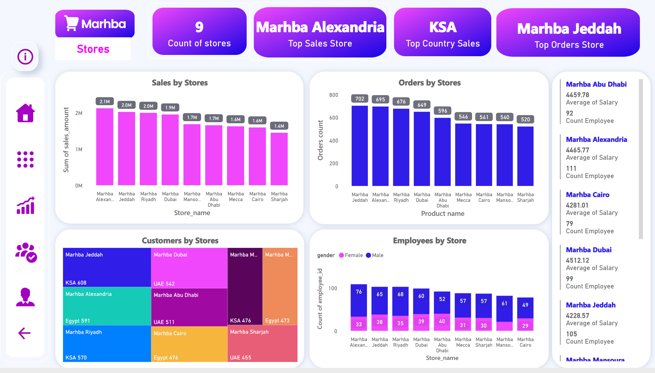
Stores
Notes:
Sales by Stores
No alt text provided
Orders by Stores
No alt text provided
Customers by Stores
No alt text provided
Employees by Store
No alt text provided
card
No alt text provided
card
No alt text provided
card
No alt text provided
card
No alt text provided
multiRowCard
No alt text provided
image
No alt text provided
card
No alt text provided
image
No alt text provided
image
No alt text provided
image
No alt text provided
image
No alt text provided
textbox
No alt text provided
image
No alt text provided
image
No alt text provided
actionButton
No alt text provided
actionButton
No alt text provided
actionButton
No alt text provided
actionButton
No alt text provided
actionButton
No alt text provided
actionButton
No alt text provided
actionButton
No alt text provided

Slide 23
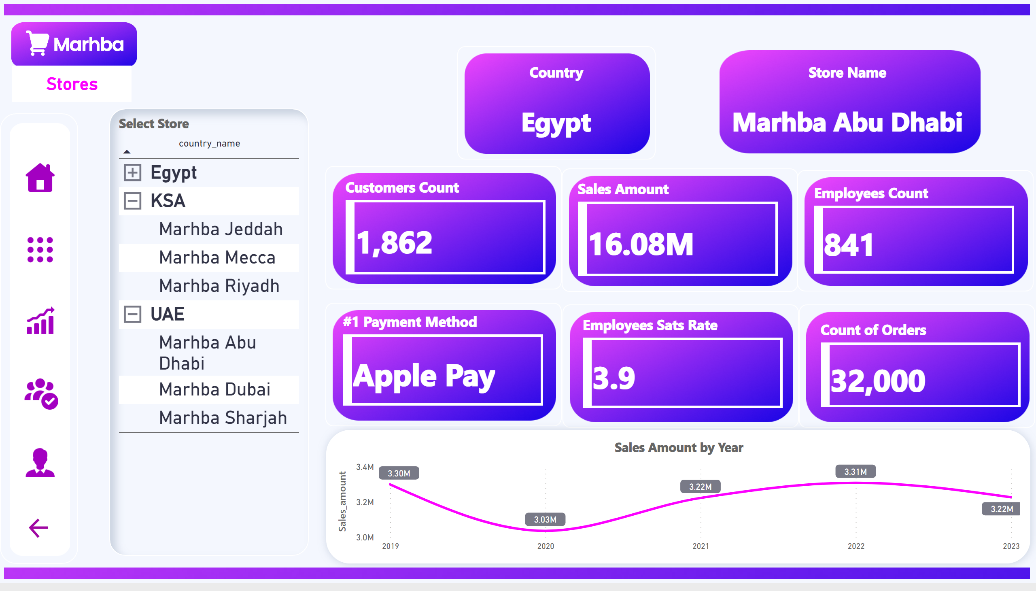
Stores Inact
Notes:
Select Store
No alt text provided
Customers Count
No alt text provided
Sales Amount
No alt text provided
Employees Count
No alt text provided
#1 Payment Method
No alt text provided
Employees Sats Rate
No alt text provided
Count of Orders
No alt text provided
Store Name
No alt text provided
Country
No alt text provided
Sales Amount by Year
No alt text provided
image
No alt text provided
image
No alt text provided
image
No alt text provided
image
No alt text provided
image
No alt text provided
image
No alt text provided
image
No alt text provided
image
No alt text provided
image
No alt text provided
image
No alt text provided
textbox
No alt text provided
image
No alt text provided
actionButton
No alt text provided
image
No alt text provided
image
No alt text provided
actionButton
No alt text provided
actionButton
No alt text provided
actionButton
No alt text provided
actionButton
No alt text provided
actionButton
No alt text provided

Slide 24
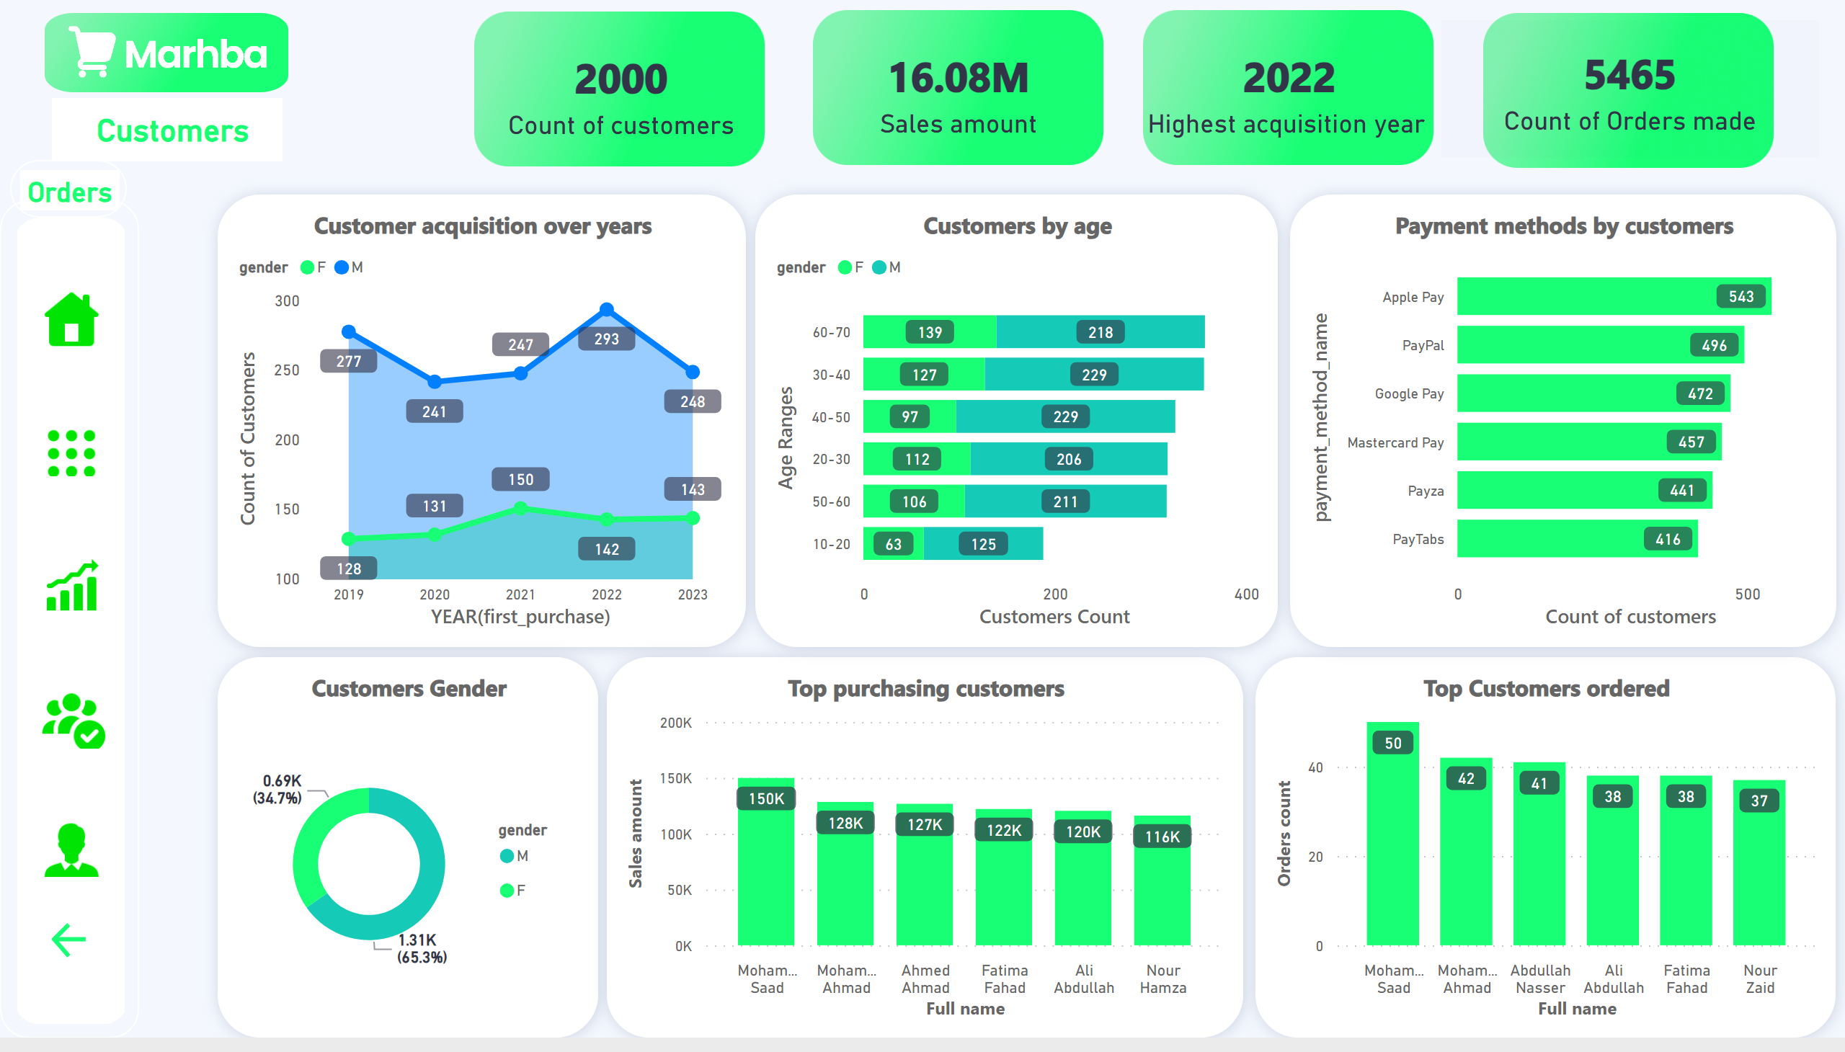
Customers
Notes:
Customer acquisition over years
No alt text provided
Customers Gender
No alt text provided
Top purchasing customers
No alt text provided
Top Customers ordered
No alt text provided
Payment methods by customers
No alt text provided
card
No alt text provided
card
No alt text provided
card
No alt text provided
card
No alt text provided
Customers by age
No alt text provided
image
No alt text provided
image
No alt text provided
image
No alt text provided
image
No alt text provided
image
No alt text provided
image
No alt text provided
textbox
No alt text provided
image
No alt text provided
actionButton
No alt text provided
actionButton
No alt text provided
actionButton
No alt text provided
actionButton
No alt text provided
actionButton
No alt text provided
actionButton
No alt text provided
actionButton
No alt text provided

Slide 25
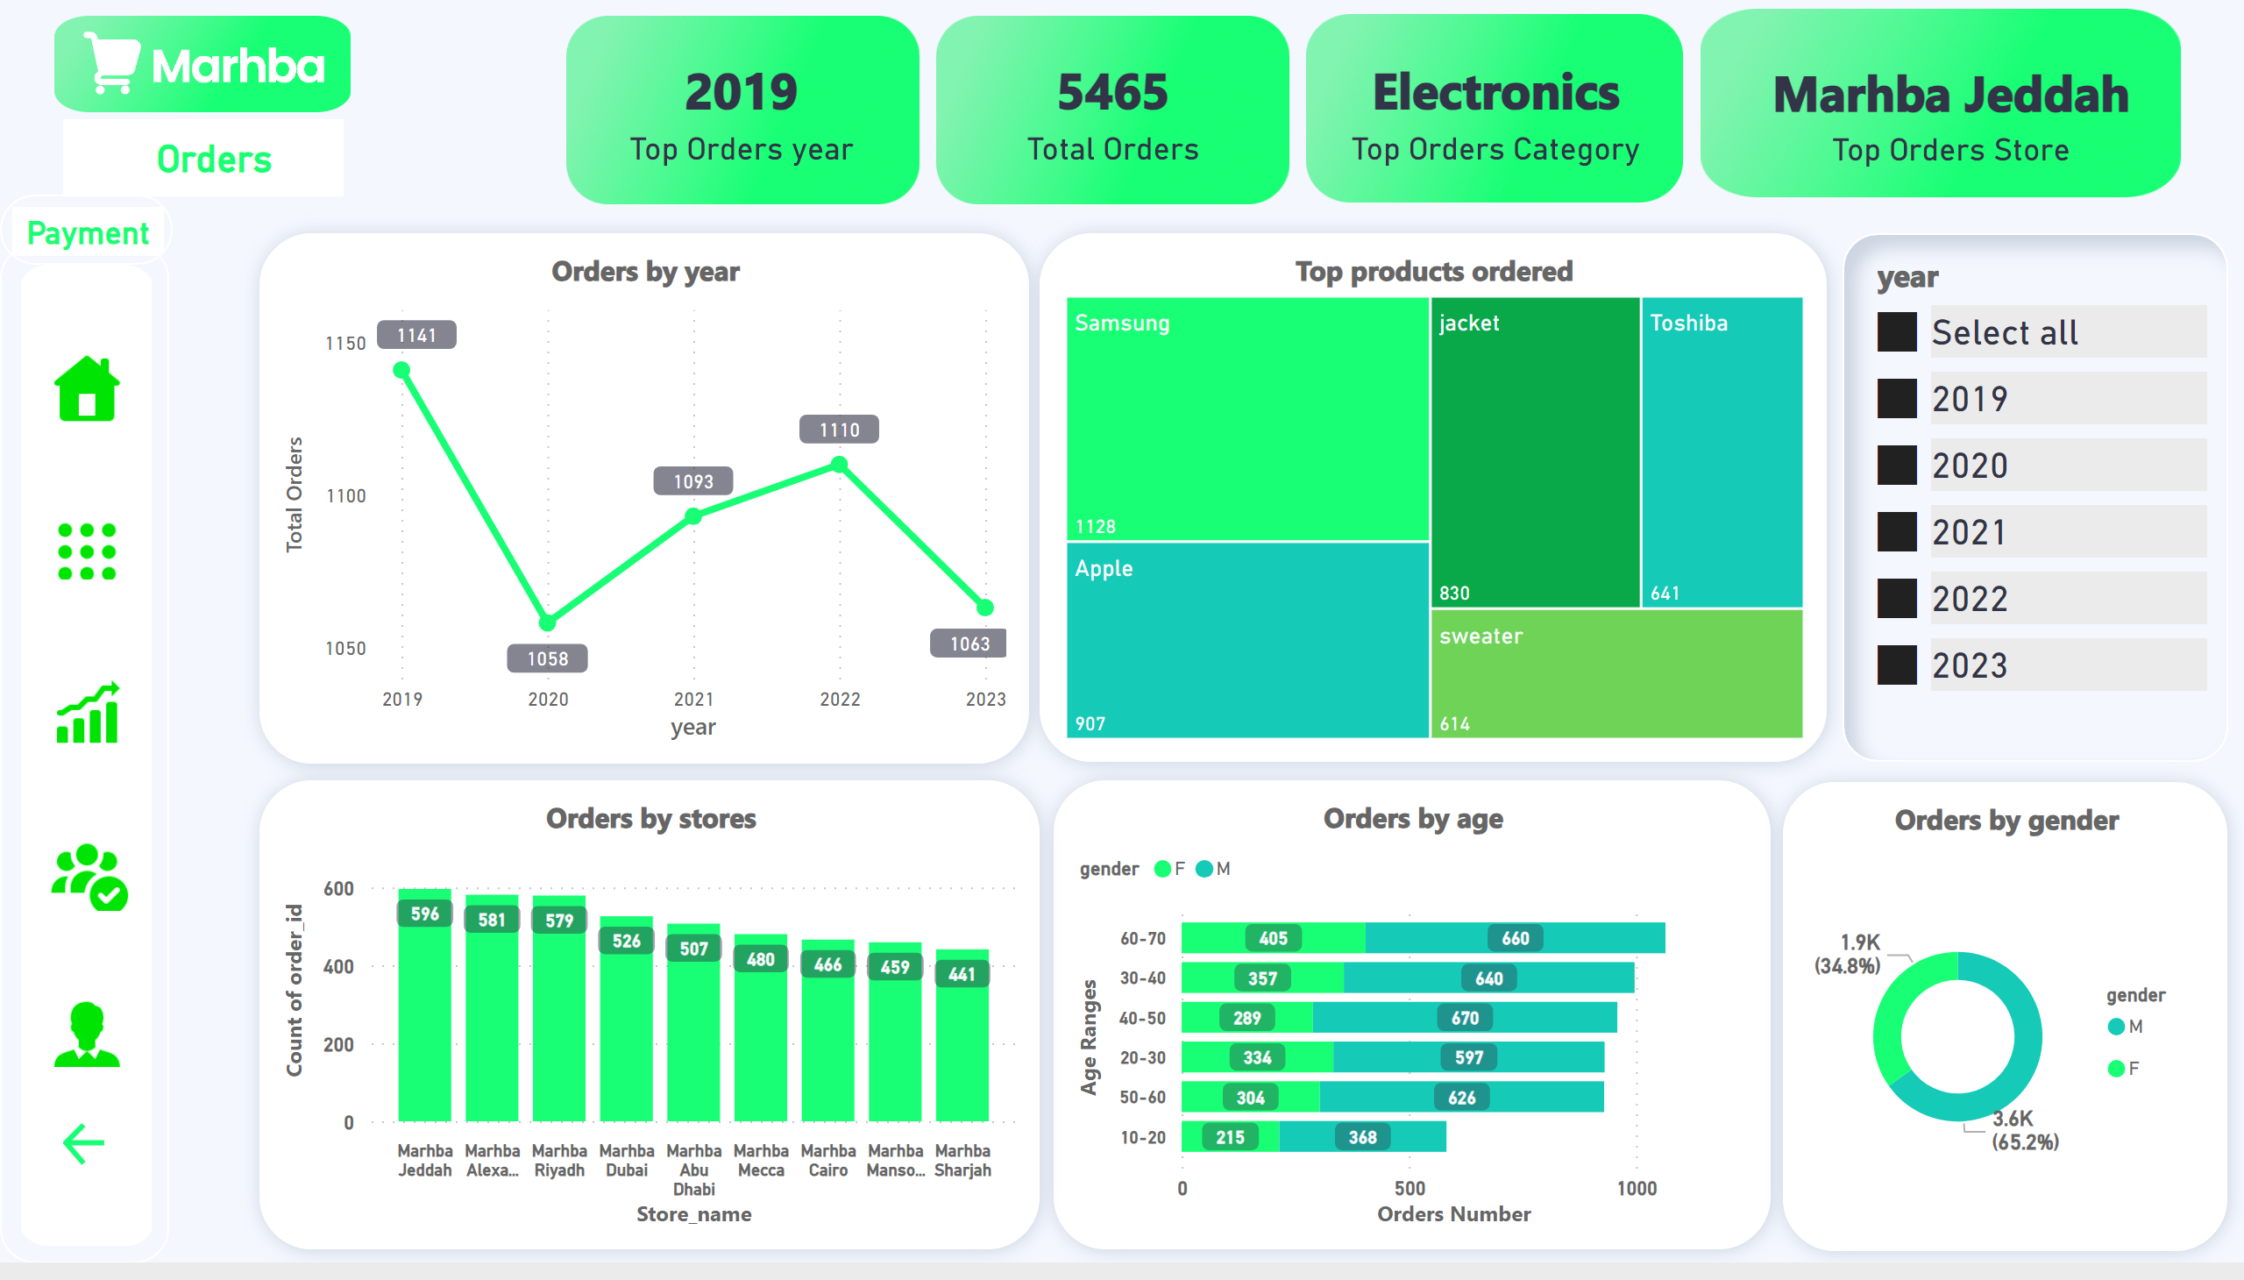
Orders Overview
Notes:
card
No alt text provided
card
No alt text provided
card
No alt text provided
card
No alt text provided
Orders by year
No alt text provided
Orders by age
No alt text provided
Top products ordered
No alt text provided
Orders by stores
No alt text provided
Orders by gender
No alt text provided
image
No alt text provided
image
No alt text provided
image
No alt text provided
image
No alt text provided
textbox
No alt text provided
image
No alt text provided
image
No alt text provided
actionButton
No alt text provided
image
No alt text provided
actionButton
No alt text provided
actionButton
No alt text provided
actionButton
No alt text provided
actionButton
No alt text provided
actionButton
No alt text provided
actionButton
No alt text provided
slicer
No alt text provided

Slide 26
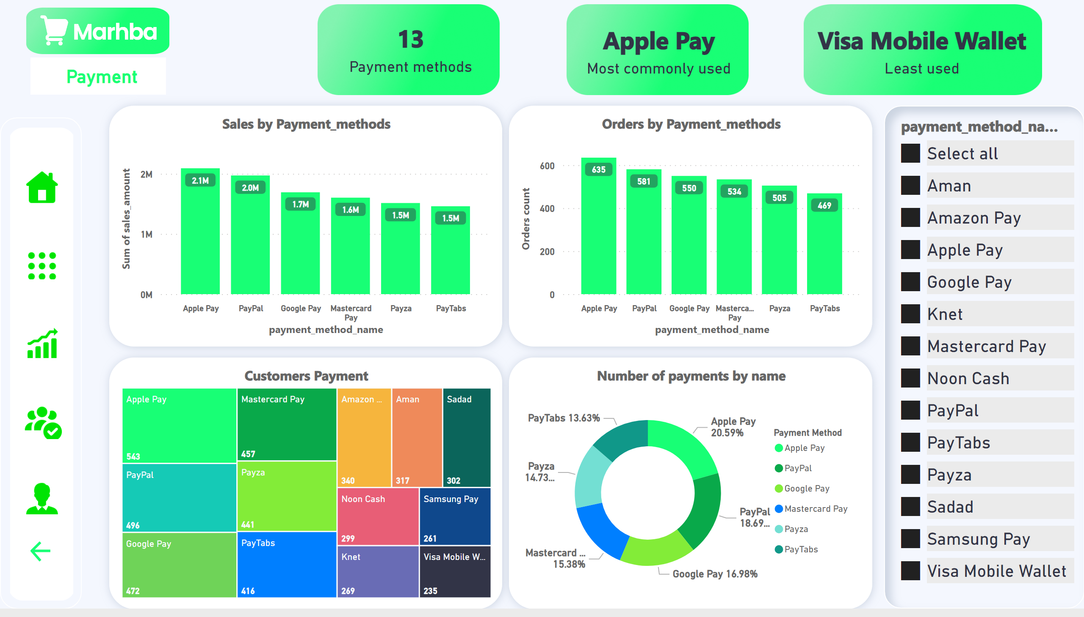
Payment
Notes:
Sales by Payment_methods
No alt text provided
Orders by Payment_methods
No alt text provided
Customers Payment
No alt text provided
slicer
No alt text provided
card
No alt text provided
Number of payments by name
No alt text provided
card
No alt text provided
card
No alt text provided
image
No alt text provided
image
No alt text provided
image
No alt text provided
textbox
No alt text provided
image
No alt text provided
image
No alt text provided
actionButton
No alt text provided
image
No alt text provided
actionButton
No alt text provided
actionButton
No alt text provided
actionButton
No alt text provided
actionButton
No alt text provided
actionButton
No alt text provided

Slide 27
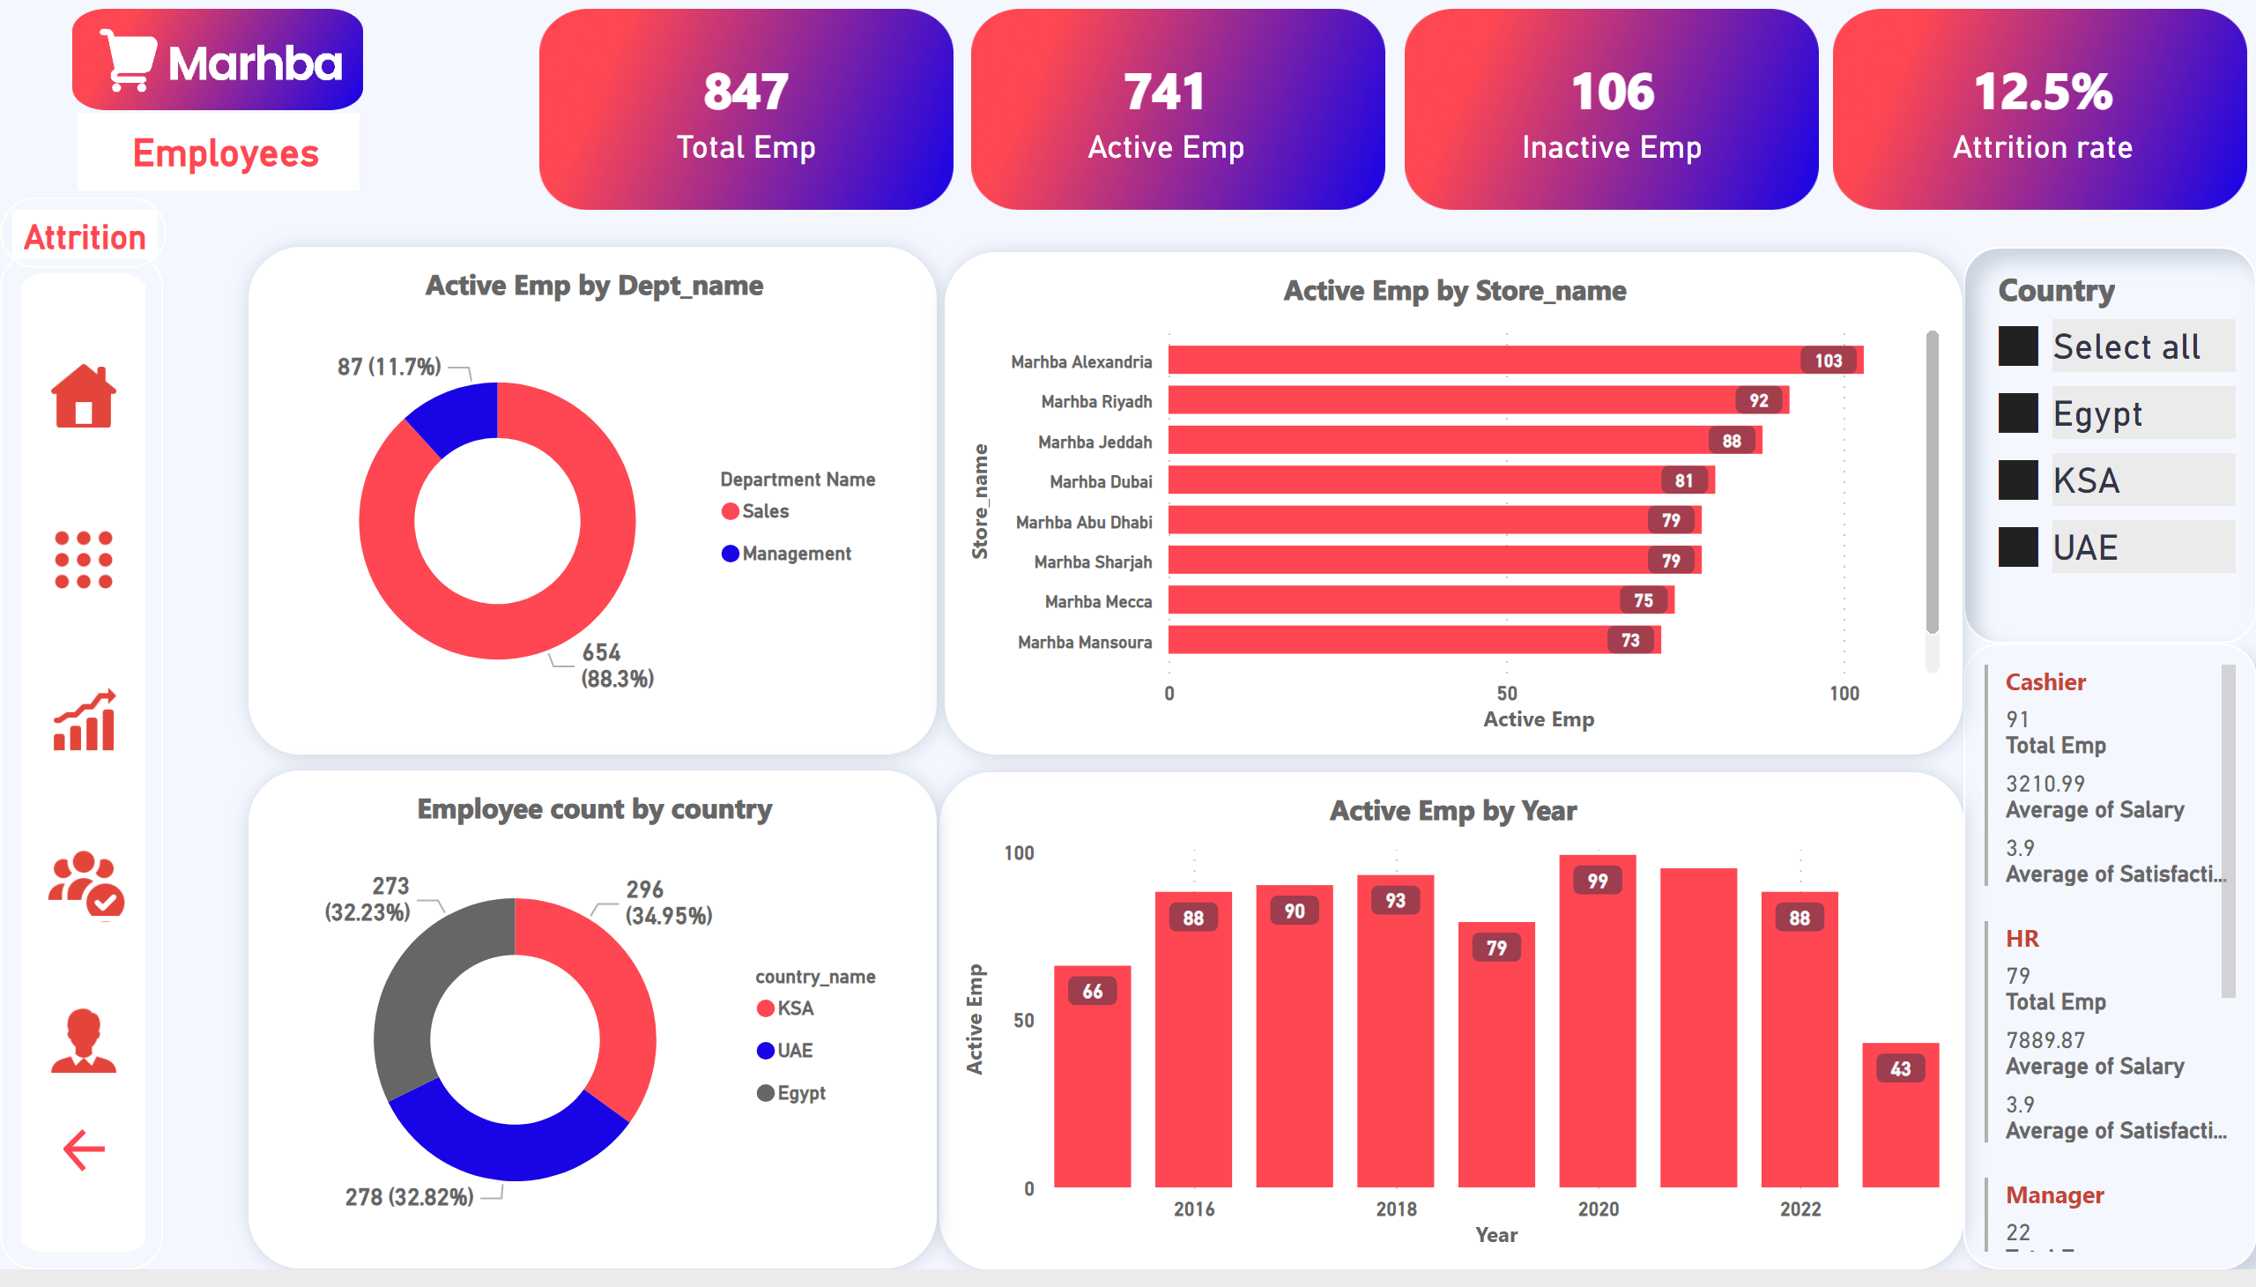
Employee Overview
Notes:
card
No alt text provided
card
No alt text provided
card
No alt text provided
card
No alt text provided
columnChart
No alt text provided
clusteredBarChart
No alt text provided
multiRowCard
No alt text provided
donutChart
No alt text provided
slicer
No alt text provided
image
No alt text provided
image
No alt text provided
image
No alt text provided
image
No alt text provided
Employee count by country
No alt text provided
image
No alt text provided
actionButton
No alt text provided
image
No alt text provided
textbox
No alt text provided
image
No alt text provided
actionButton
No alt text provided
actionButton
No alt text provided
actionButton
No alt text provided
actionButton
No alt text provided
actionButton
No alt text provided
actionButton
No alt text provided

Slide 28
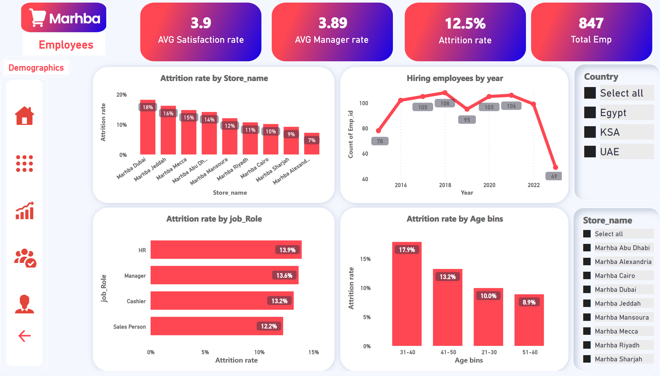
Attrition
Notes:
card
No alt text provided
clusteredColumnChart
No alt text provided
clusteredColumnChart
No alt text provided
clusteredBarChart
No alt text provided
Hiring employees by year
No alt text provided
slicer
No alt text provided
slicer
No alt text provided
card
No alt text provided
card
No alt text provided
card
No alt text provided
image
No alt text provided
image
No alt text provided
image
No alt text provided
image
No alt text provided
actionButton
No alt text provided
image
No alt text provided
textbox
No alt text provided
image
No alt text provided
image
No alt text provided
actionButton
No alt text provided
actionButton
No alt text provided
actionButton
No alt text provided
actionButton
No alt text provided
actionButton
No alt text provided
actionButton
No alt text provided

Slide 29
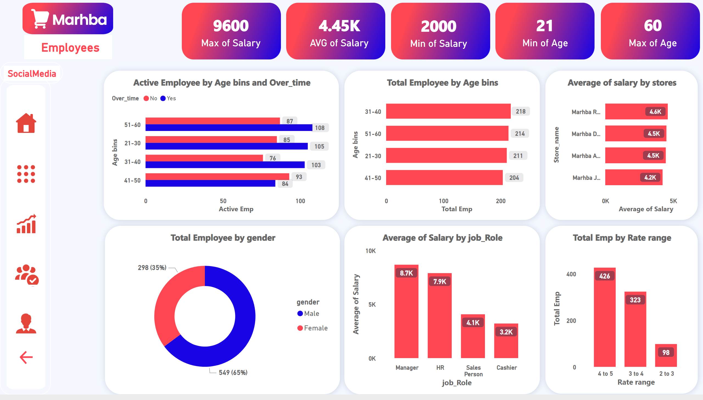
Demographics
Notes:
card
No alt text provided
card
No alt text provided
Total Employee by Age bins
No alt text provided
Total Employee by gender
No alt text provided
columnChart
No alt text provided
Active Employee by Age bins and Over_time
No alt text provided
card
No alt text provided
card
No alt text provided
card
No alt text provided
Average of salary by stores
No alt text provided
columnChart
No alt text provided
image
No alt text provided
image
No alt text provided
image
No alt text provided
image
No alt text provided
image
No alt text provided
actionButton
No alt text provided
image
No alt text provided
textbox
No alt text provided
image
No alt text provided
image
No alt text provided
actionButton
No alt text provided
actionButton
No alt text provided
actionButton
No alt text provided
actionButton
No alt text provided
actionButton
No alt text provided
actionButton
No alt text provided

Slide 30
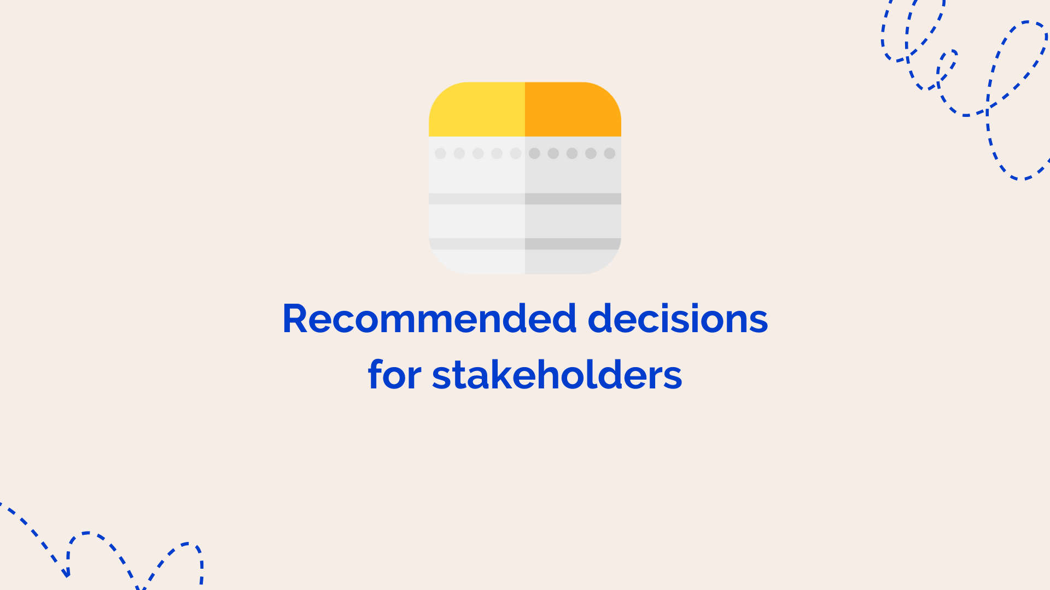

Slide 31
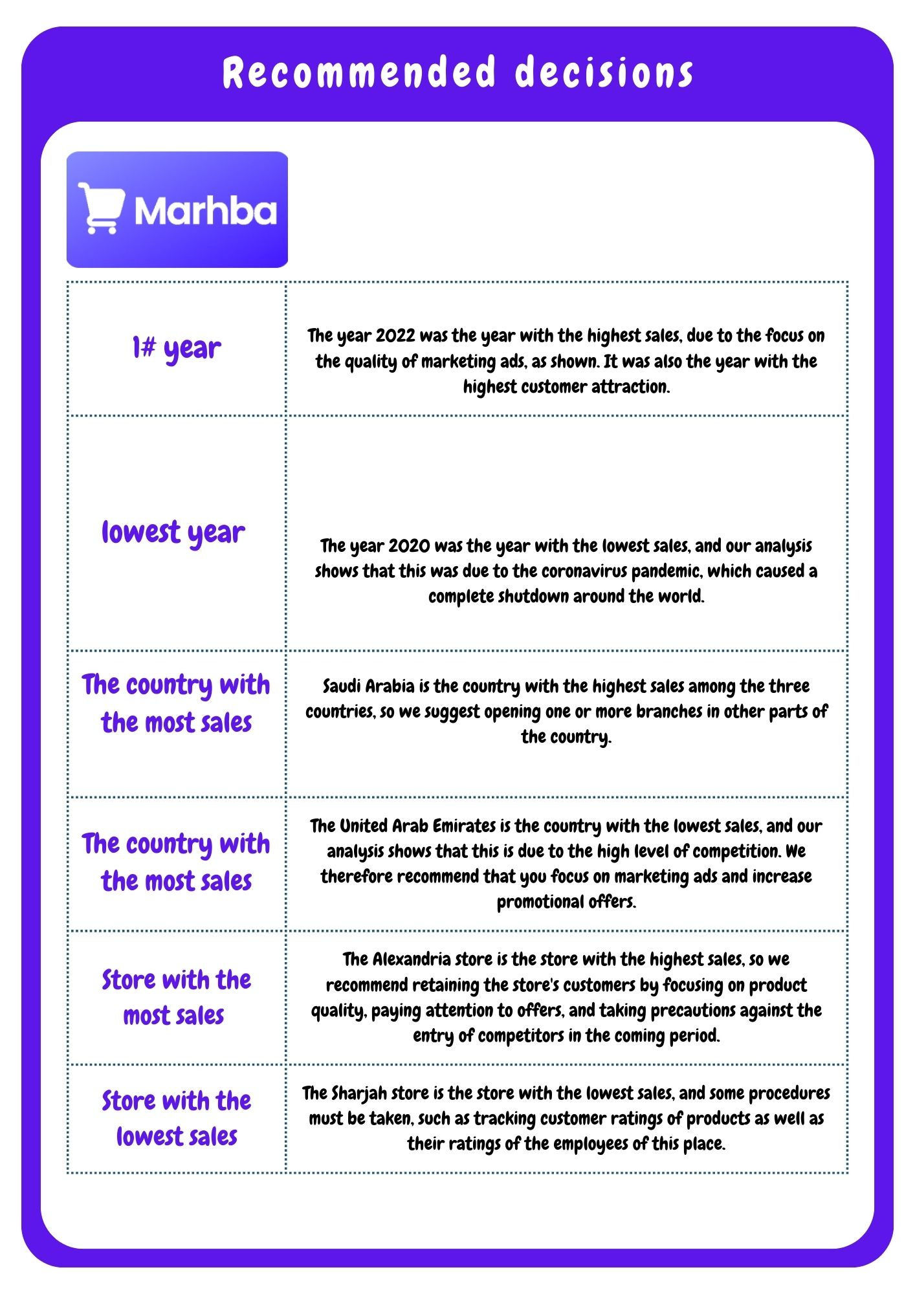
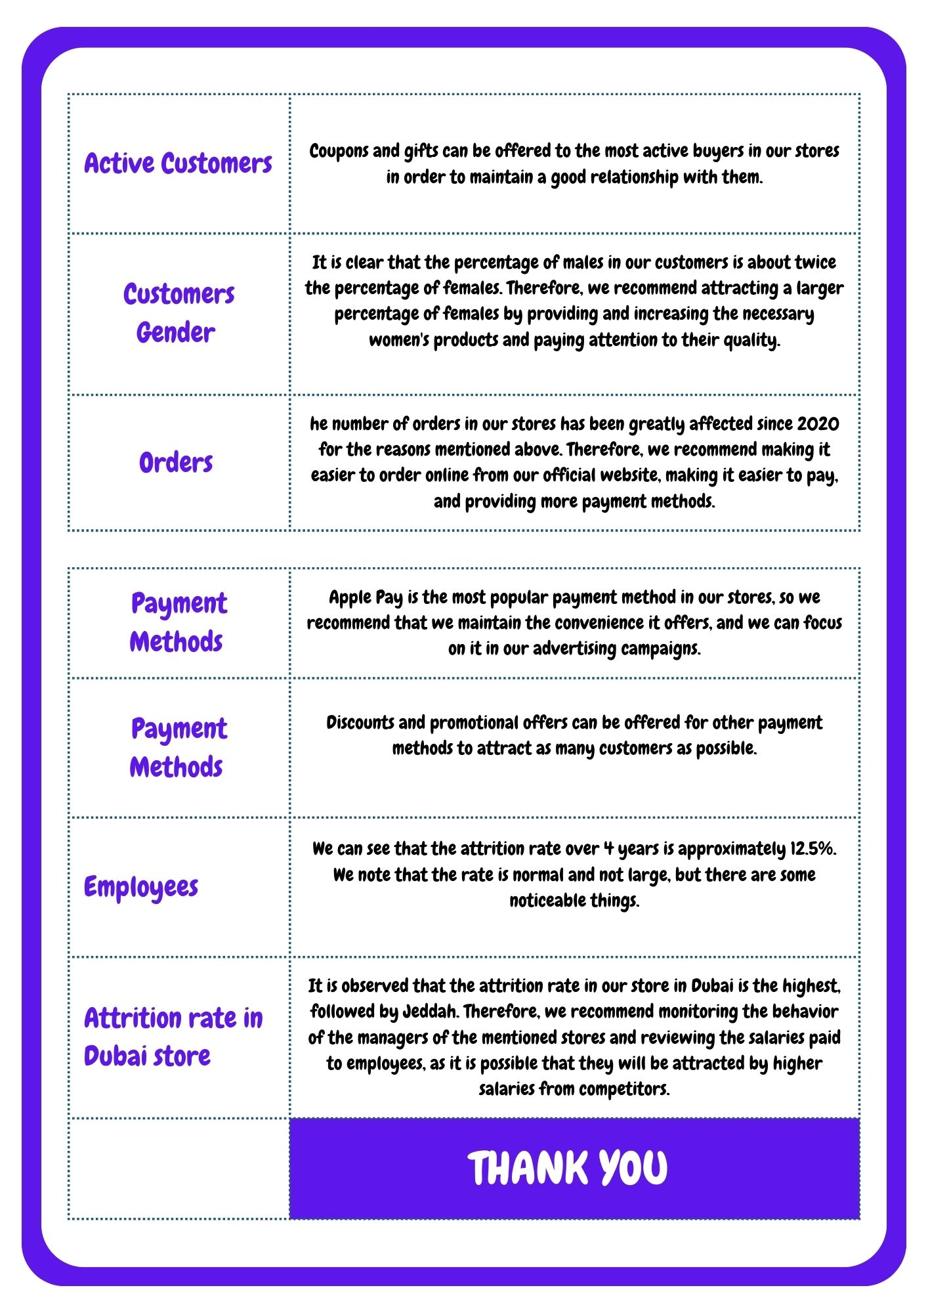

Slide 32


Slide 33
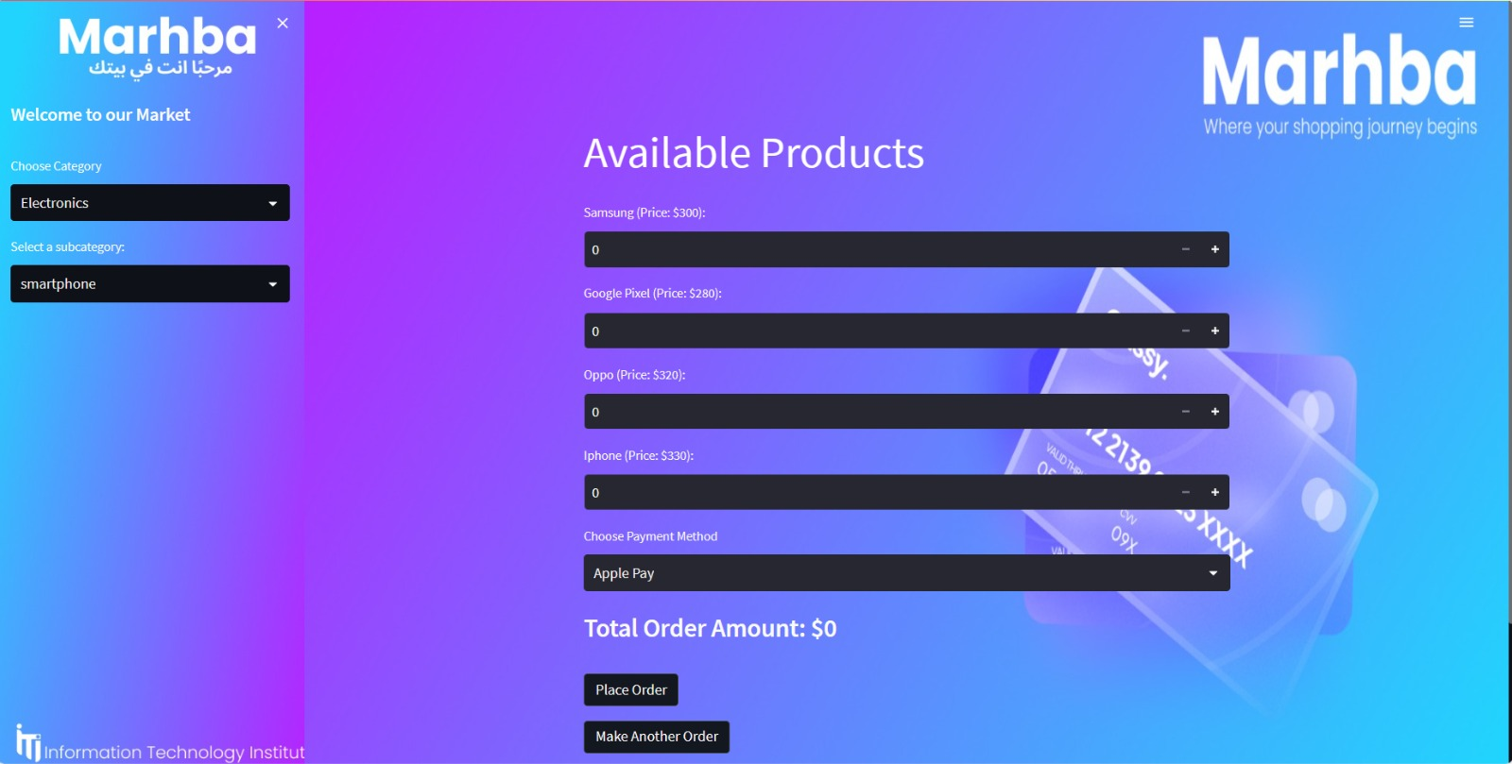

Slide 34
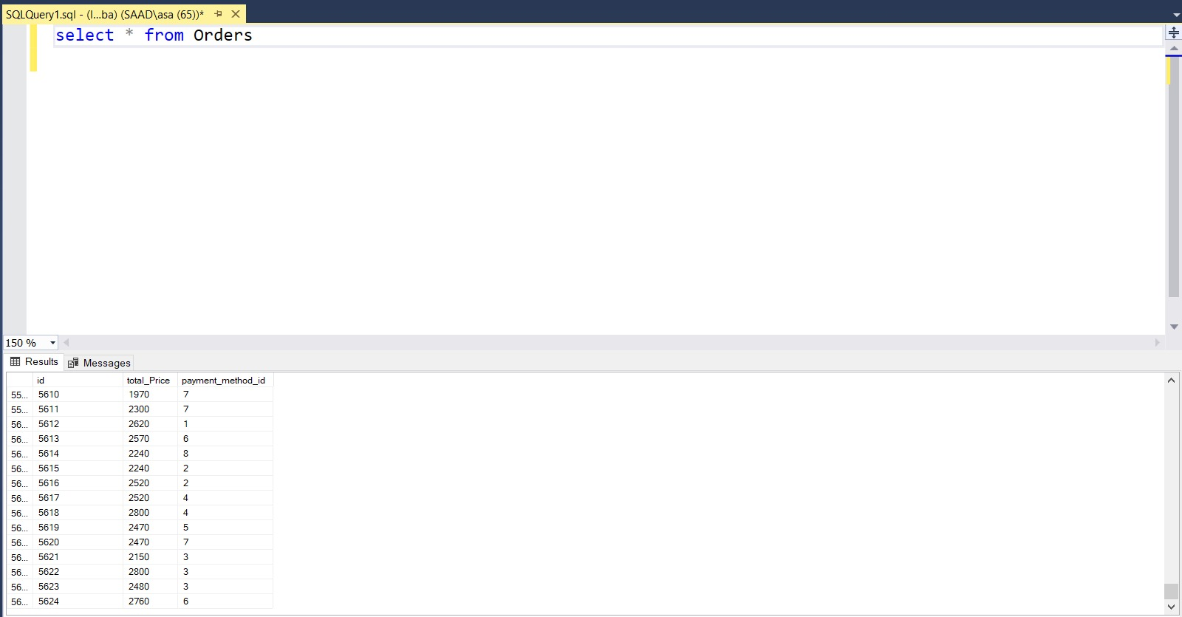

Before placing an order
,Orders count = 5624

Slide 35
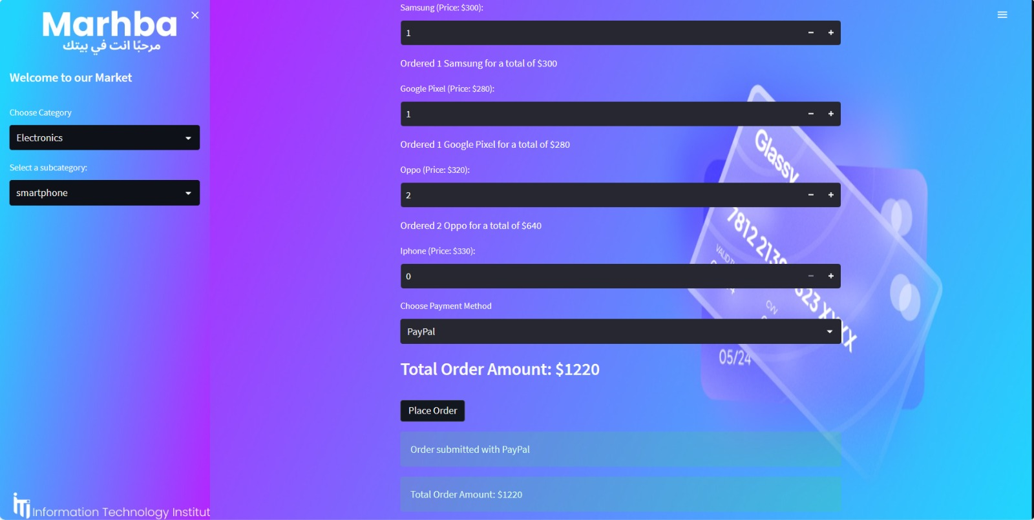

Slide 36
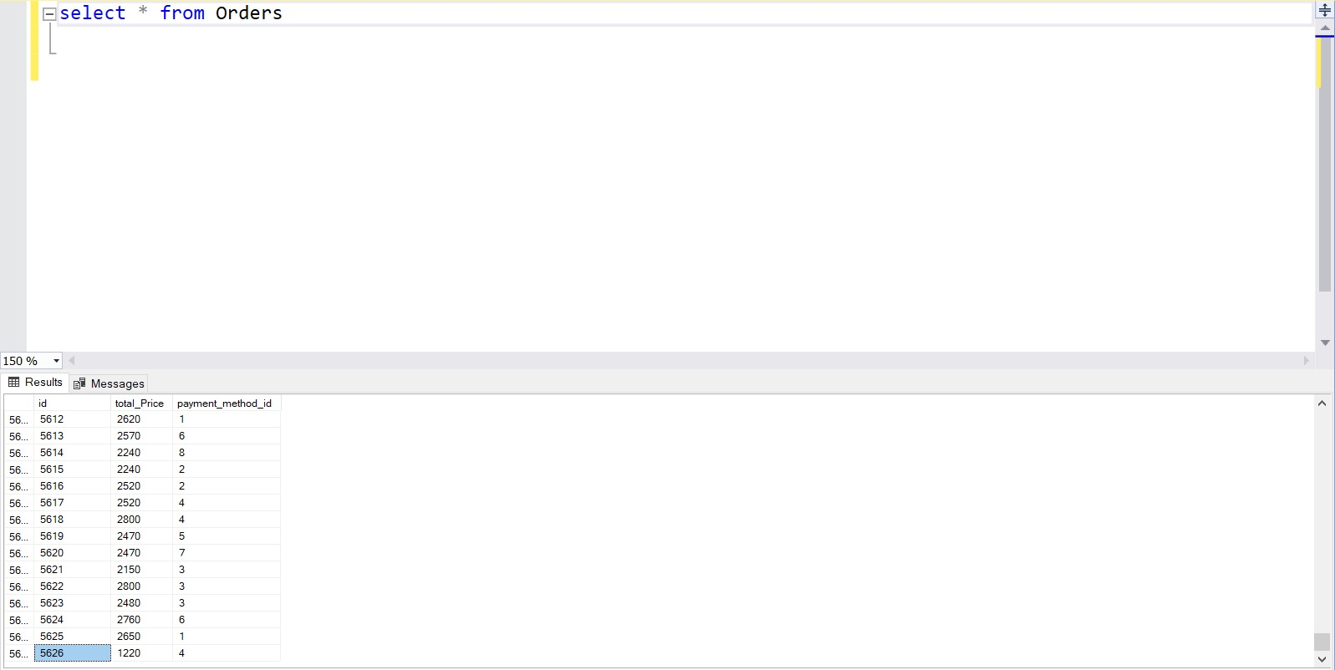
After placing two orders
,Orders count = 5626

Slide 37
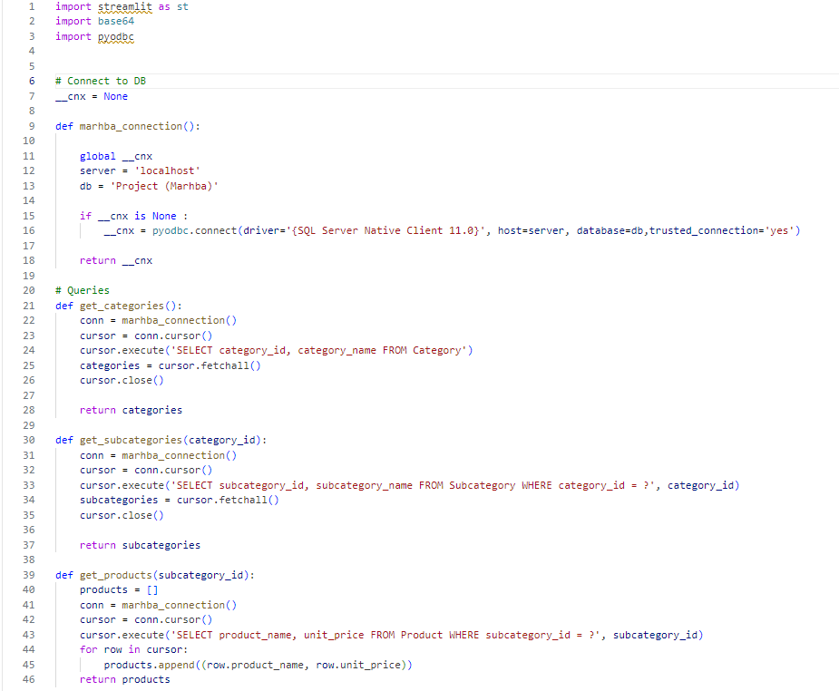

Slide 38
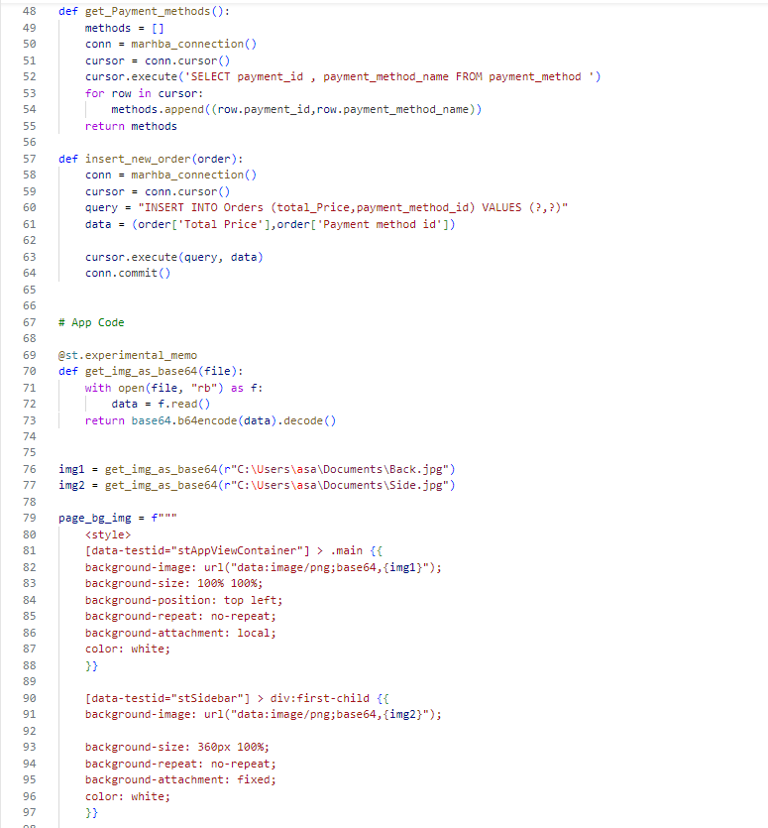

Slide 39
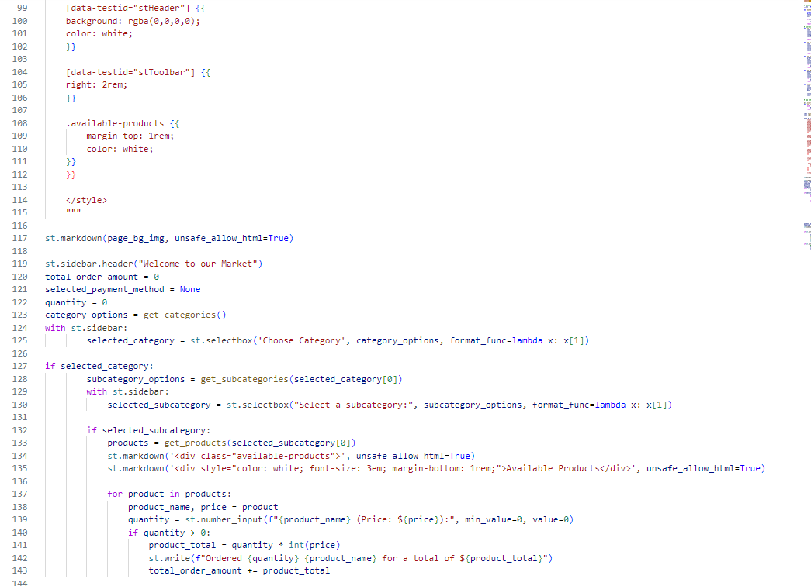

Slide 40
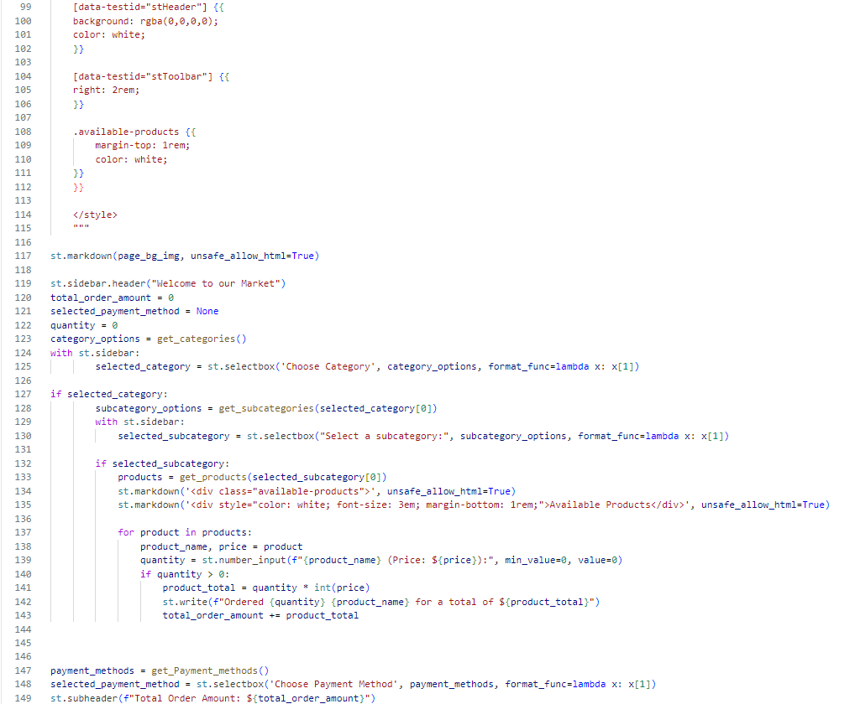

Slide 41
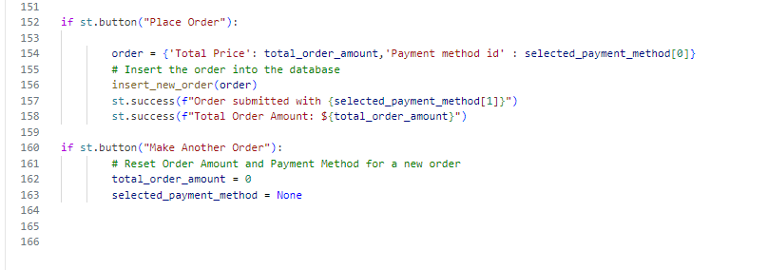

Slide 42


Slide 43


